Slide 1

Science Learning Partnership (SLP) Cornwall – your Science Curriculum Hub for Cornwall
Ben Riley (Secondary) & Zoe Vale (Primary)

Slide 2


STEM Learning
Is the largest provider of education and careers support in science, technology, engineering and mathematics (STEM).
We work with schools, colleges and others working with young people across the UK. Our mission is to improve lives through education and ensure that every young person across the UK can access the world-leading STEM education they deserve.

Slide 3
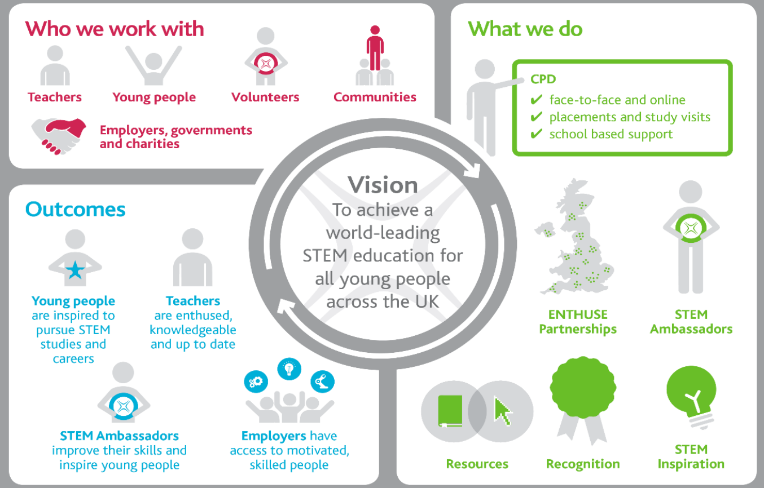

Slide 4
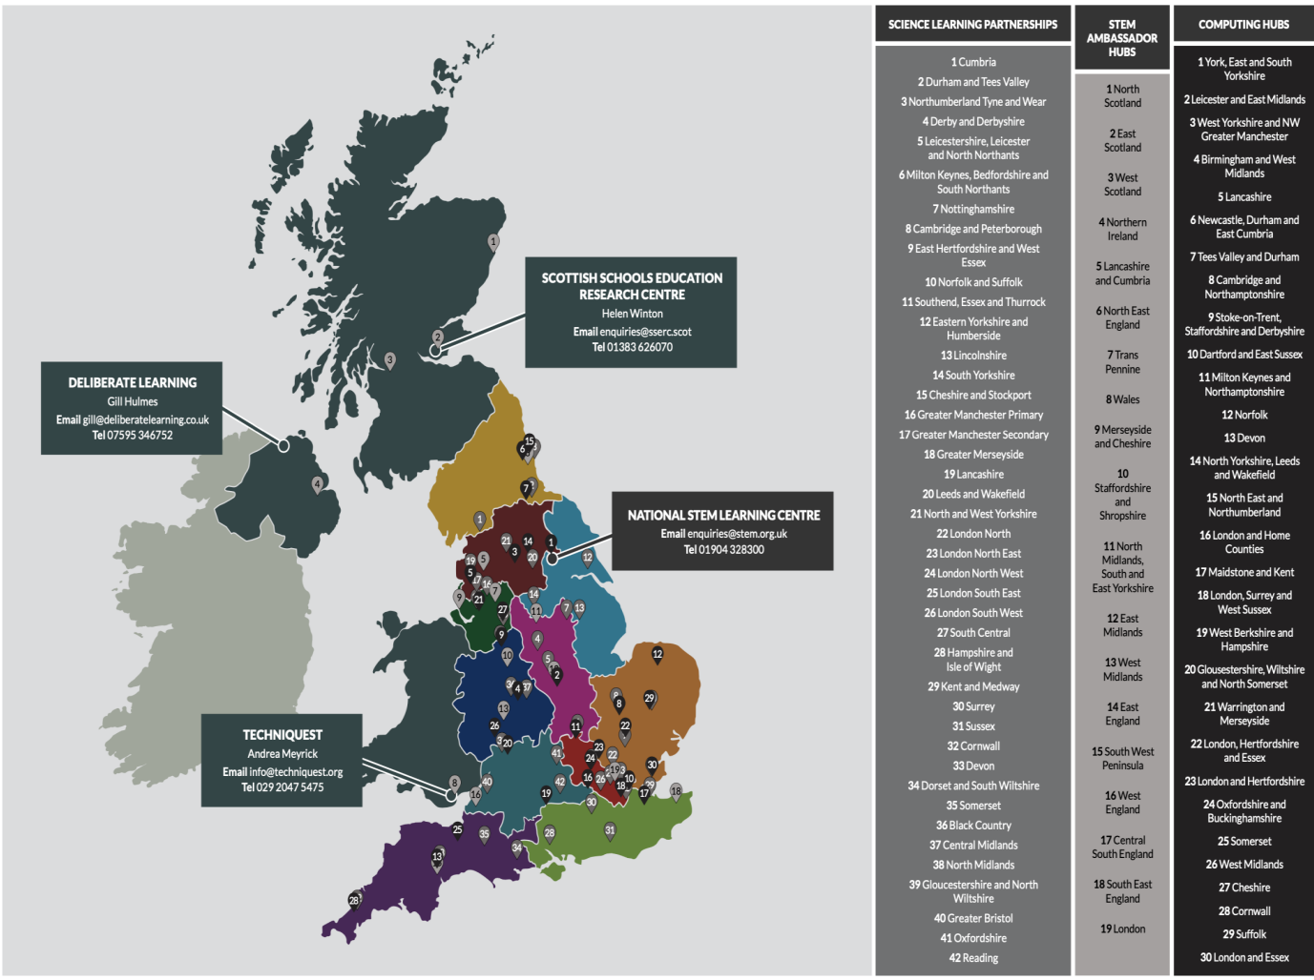

Slide 5
Slp
Science Learning Partnership
We are the Science Curriculum HUB for Cornwall – ‘the go-to place for science support, working together locally and regionally to identify gaps and provide collaborative engagement opportunities.’ We are here to ensure that Cornwall has the highest quality CPD for science that meets the needs of our schools from EYFS to post-16!
Ben Riley – former Secondary Head of Science and current Teacher of Science at Hayle Academy.
Zoe Vale - Year 3 Primary School Teacher at Threemilestone and Science Lead in supporting science across the Truro and Penwith Academy Trust.

Slide 6
STEM Learning impact
CPD improves student attainment and progression
Engaged secondary schools show more than 10% increases in the proportion of students achieving two good GCSE passes in science
ENTHUSE partnerships help ‘closing the gap’: 94% of PP students meeting or exceeding expectations in STEM.
Over 4,500 additional students progressed to STEM A levels.
Our CPD improves Teacher Retention Engagement with our support is 160% more likely to keep teachers of STEM subjects in the classroom- raising to 190% of newly qualified teachers

Slide 7
What we offer in cornwall
Core programme - Courses/conferences face to face and remote
Bespoke sessions for individual schools/ MATs – depts/individuals/whole school
Packages – Early careers. Pedagogy, SKE
Partnerships: CLEAPPS, Physics partners, RSC, ASE, Ogden Trust (SKPT), SPN

Slide 8
Secondary Science Department Support Package 22-23
This package has been designed to support all of your science department from ECT’s to subject leaders.
Developed and delivered and administered by the Science Learning Partnership for Cornwall. The STEM Learning Network provides high quality locally nationally developed professional learning on a local basis through Science Learning Partnerships (SLPs). We are also able to provide advice and guidance pertaining to the science curriculum and to signpost you to resources and other professional bodies who can help.
Book now https://www.stem.org.uk/cpd/516843/cornwall-science-department-support-package

Slide 9
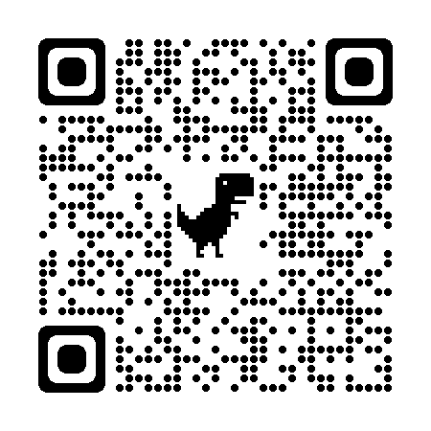
Secondary Science Department Support Package 22-23
Activity | Frequency/ duration | When | Location
Subject Leader Network | Once per term, half day, F2F | 7.11.22 | 1st Wadebridge
 |  | 24.3.22 | 2nd TBC
 |  | 22.6.23 | 3rd TBC
Early Career Teacher Network | Once per half term, 1 hr, remote | 9.11.22 | Remote
Pedagogy Network | Once per half term, 1.5 hr, remote | 29.11.22 | Remote
Technician Network | Once per term, 2hr F2F | 28th Nov 13:30-15:30 | Mounts Bay Academy
 |  | Date TBC
 |  | 3rd July 2023
Secondary Conference | Once per year, F2F | 30.6.23 from 9.00-15.30 | Academy House, Threemilestone, Truro
Whole package cost Per school |  | £960.00 | Less £600.00 subsidy = £350.00 to pay

Slide 10
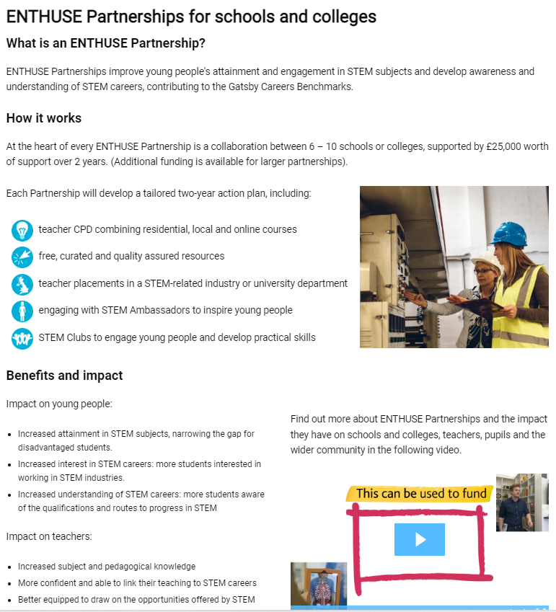
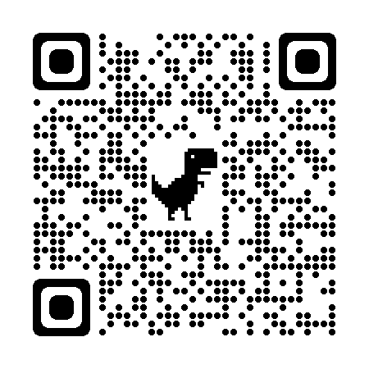
Bespoke CPD & Enthuse Partnerships
Look out for future emails about the new super-ENTHUSE partnerships based around the Spaceport as well as our network meetings and other CPD you can book onto!

Slide 11

Funding (TRP)
There is funding available. We are keen to help everyone access this order to improve science teaching in Cornwall so get in touch if you are interested. Department for Education additional support subsidy | STEM
Stimulating Physics Network (SPN) – complete a needs analysis and also receive £300 to spend on SLP (CPD STEM Learning Courses

Slide 12

SPN
Stimulating Physics Network (SPN) – complete a needs analysis and also receive £300 to spend on SLP (CPD STEM Learning) courses.

Slide 13
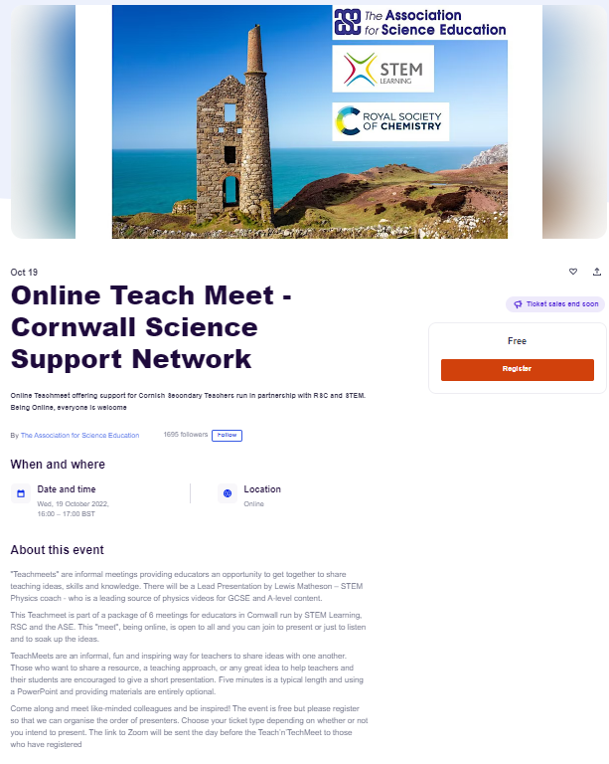
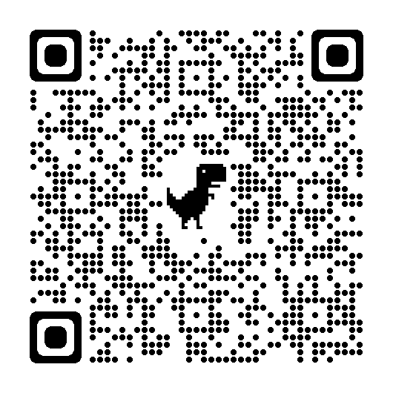
SPN

Slide 14

Needs analysis
We are planning a CPD schedule for the year based on needs analysis from schools. Please use this google form to let us know how we could further support you. We will of course still be running science lead network meetings as well as offering packages and cpd subscriptions.
Our first course is fully funded and is to train our new Professional Development Leaders

Slide 15
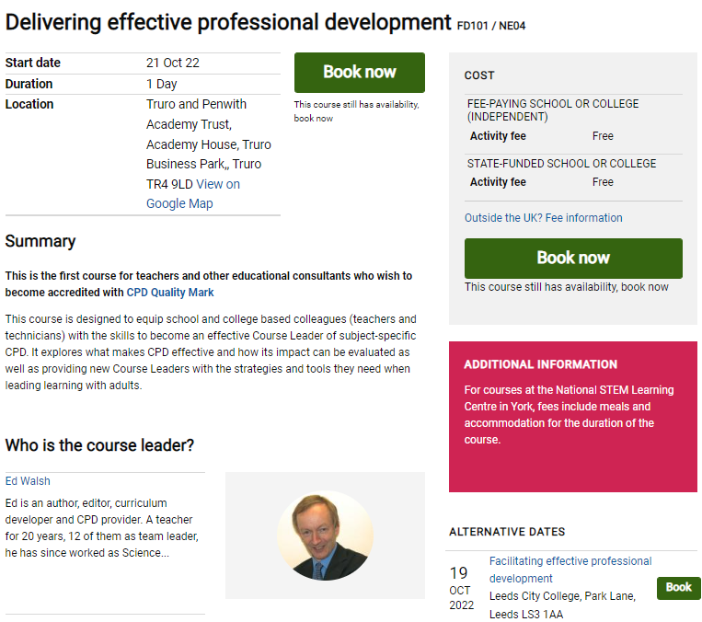
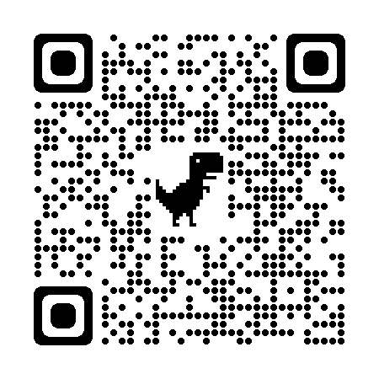
CPD Delivery Training

