Slide 1

Science Learning Partnership (SLP) Cornwall – your Science Curriculum Hub for Cornwall
Ben Riley (Secondary) & Zoe Vale (Primary)
Ben.riley@hayleacademy.net
zvale@threemilestone.cornwall.sch.uk
cornwallsciencehub@tpacademytrust.org

Slide 2


STEM Learning
Is the largest provider of education and careers support in science, technology, engineering and mathematics (STEM).
We work with schools, colleges and others working with young people across the UK. Our mission is to improve lives through education and ensure that every young person across the UK can access the world-leading STEM education they deserve.

Slide 3
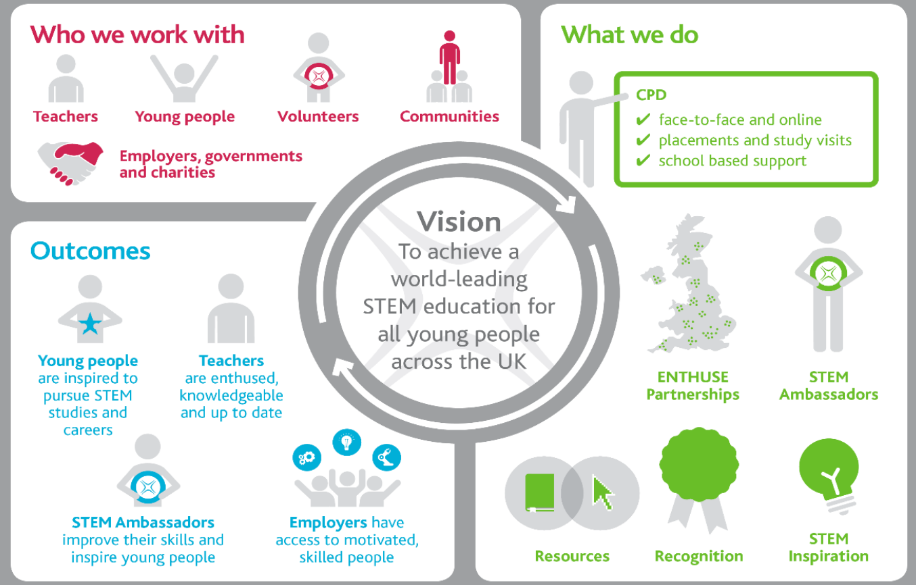

Slide 4
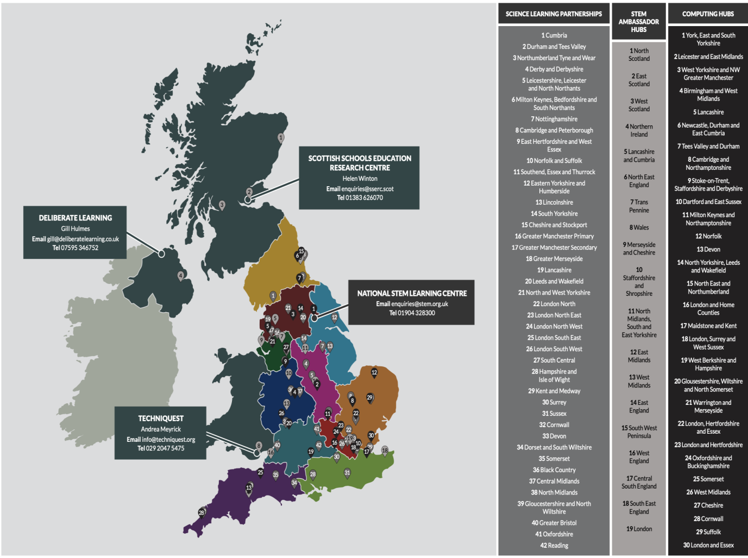

Slide 5
Slp
Science Learning Partnership
We are the Science Curriculum HUB for Cornwall – ‘the go-to place for science support, working together locally and regionally to identify gaps and provide collaborative engagement opportunities.’ We are here to ensure that Cornwall has the highest quality CPD for science that meets the needs of our schools from EYFS to post-16!
Ben Riley – former Secondary Head of Science and current Teacher of Science at Hayle Academy.
Zoe Vale - Year 3 Primary School Teacher at Threemilestone and Science Lead in supporting science across the Truro and Penwith Academy Trust.

Slide 6
STEM Learning impact
CPD improves student attainment and progression
Engaged secondary schools show more than 10% increases in the proportion of students achieving two good GCSE passes in science
ENTHUSE partnerships help ‘closing the gap’: 94% of PP students meeting or exceeding expectations in STEM.
Over 4,500 additional students progressed to STEM A levels.
Our CPD improves Teacher Retention Engagement with our support is 160% more likely to keep teachers of STEM subjects in the classroom- raising to 190% of newly qualified teachers

Slide 7
What we offer in cornwall
Core programme - Courses/conferences face to face and remote
Bespoke sessions for individual schools/ MATs – depts/individuals/whole school
Packages – Early careers. Pedagogy, SKE
Partnerships: CLEAPPS, Physics partners, RSC, ASE, Ogden Trust (SKPT), SPN

Slide 8
Primary science cpd Package 22-23
This package has been designed to support all of your science department from ECT’s to subject leaders.
Developed and delivered and administered by the Science Learning Partnership for Cornwall. The STEM Learning Network provides high quality locally nationally developed professional learning on a local basis through Science Learning Partnerships (SLPs). We are also able to provide advice and guidance pertaining to the science curriculum and to signpost you to resources and other professional bodies who can help.
Book now https://www.stem.org.uk/cpd/517560/cornwall-primary-science-support-package

Slide 9
Why subscribe to the package?
Package membership gives access to high quality, facilitator led, subject specific CPD. By collaborating with other schools, we increase the opportunity for sharing expertise and good practice. Science teachers have access to a network of colleagues, all of whom will be facing similar challenges and opportunities, and teachers can learn from each other. There are sometimes further opportunities for participating in projects, and schools that are already collaborating are better placed to apply for these (i.e. Ogden Trust and Enthuse partnerships)

Slide 10
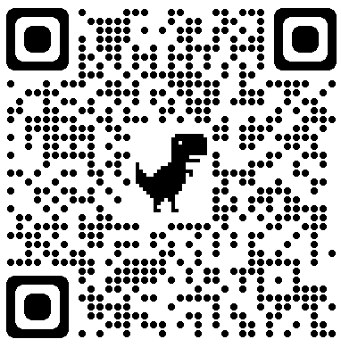
Primary Science cpd Package 22-23
Activity | Frequency/ duration | Date/Location
Subject Leader focused CPD session | Once per term, full day, F2F | TBC
Subject knowledge enhancement session | Once per term, full day, F2F
Whole package cost per person |  | £450.00 | Less £300.00 subsidy = £150.00 to pay

Slide 11
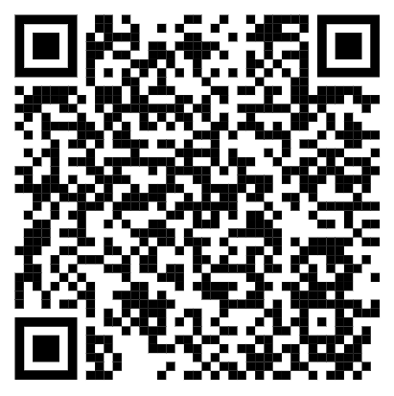
Southwest primary science share 22-23
Session focus | Date | Time
Royal Society of Chemistry | 11.10.22 | 16.00-17.00
Primary Science Teaching Trust | 29.11.22
STEM Learning UK | 7.2.23
Association of Science Education | 28.3.23
STEM Ambassador Hub | 2.5.23
TBC | 27.6.23
Use this to book onto all available sessions
Online, free CPD and networking with other schools across the southwest and Science partners including PSTT, ASE, RSC and IoP.

Slide 12
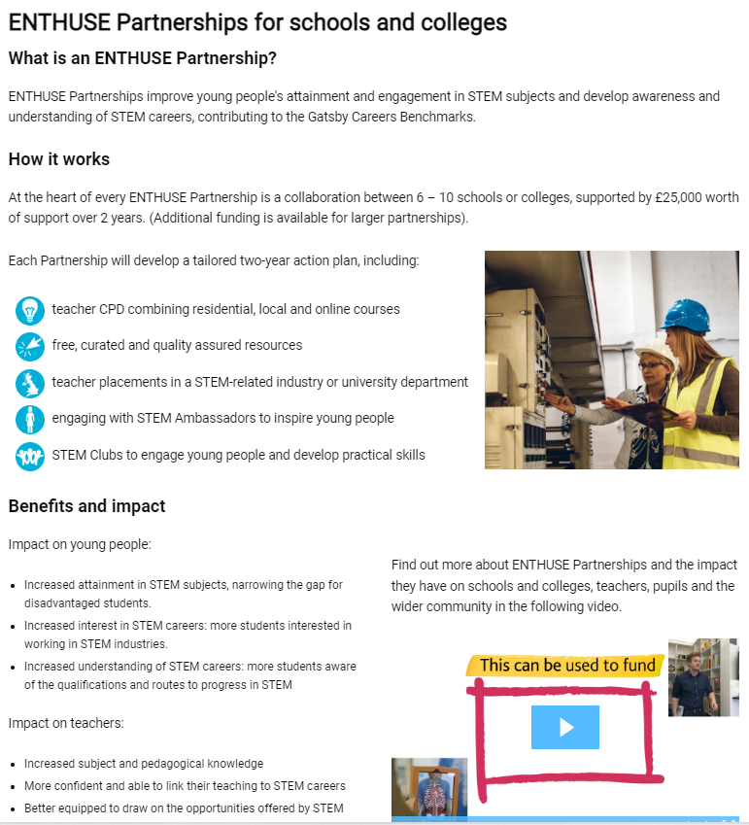
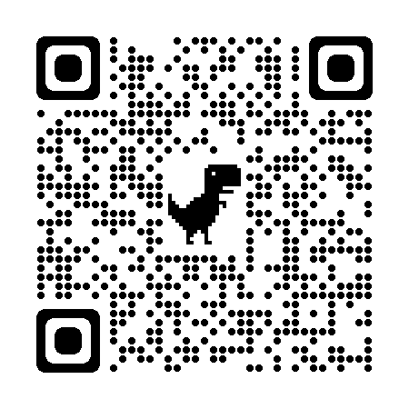
Bespoke CPD & Enthuse Partnerships
Look out for future emails about the new super-ENTHUSE partnerships based around the Spaceport as well as our network meetings and other CPD you can book onto!

Slide 13

Funding (TRP)
There is funding available. We are keen to help everyone access this order to improve science teaching in Cornwall so get in touch if you are interested. Department for Education additional support subsidy | STEM
Stimulating Physics Network (SPN) – complete a needs analysis and also receive £300 to spend on SLP (CPD STEM Learning Courses

Slide 14

SPN
Stimulating Physics Network (SPN) – complete a needs analysis and also receive £300 to spend on SLP (CPD STEM Learning) courses.

Slide 15
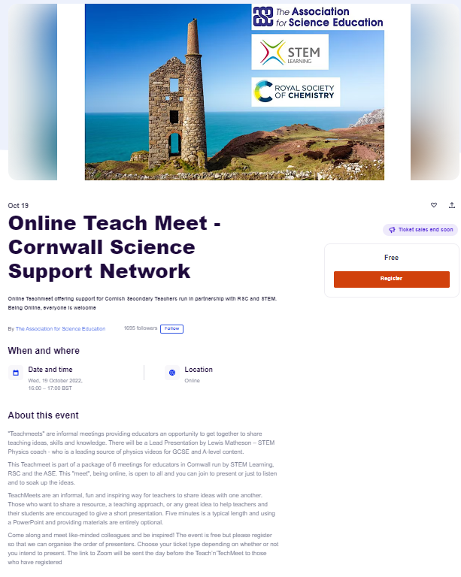

SPN

Slide 16

Needs analysis
We are planning a CPD schedule for the year based on needs analysis from schools. Please use this google form to let us know how we could further support you. We will of course still be running science lead network meetings as well as offering packages and cpd subscriptions.
Our first course is fully funded and is to train our new Professional Development Leaders

Slide 17
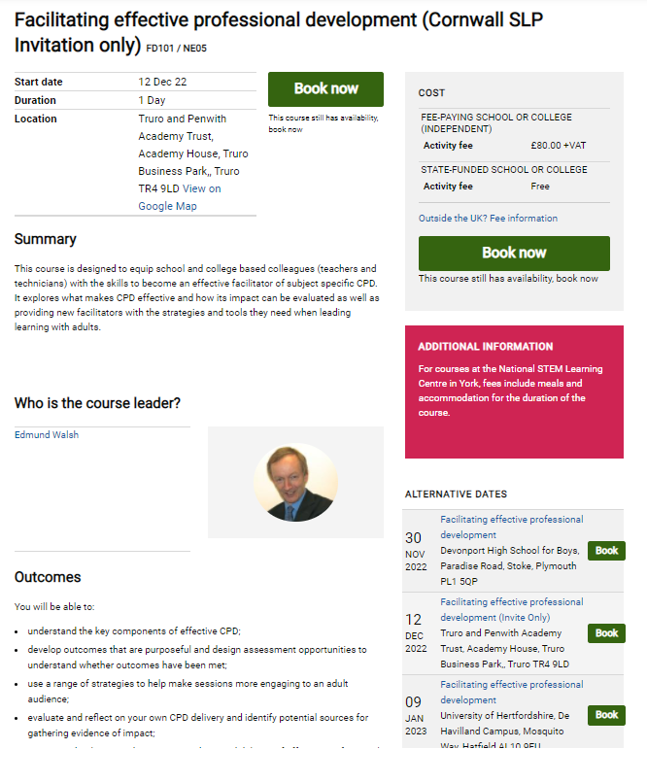
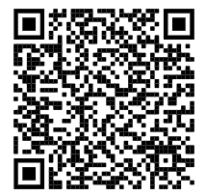
CPD Delivery Training

